Slide 1
EU4Business EU SUPPORT TO SMEs IN UKRAINE
EU4Business week
SMEs Donors' Forum
MIM-Kyiv Business school, 12 July 2016

Slide 2
1. SMEs potential in Ukraine and main
challenges
2. Horizon 2020
3. COSME
4. EU Export Hepldesk
5. EU4Business –bilateral and regional
projects

Slide 3
SMEs in Ukraine: a huge potential

Slide 4
Main challenges faced by SMEs
..Inadequate legal and regulatory framework
..Limited knowledge base / business skills
..Poor access to finance
..Limited access to markets

Slide 5
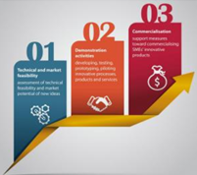
Horizon 2020 - SME instrument
What is Horizon 2020?
The SME Instrument…
Notes:
The biggest ever EU Research and Innovation programme, nearly € 80 billion of funding for the period 2014-2020, in addition to private investment that this money will attract.
Within the SME instrument, SMEs based in the EU or in the associated countries can get EU funding and support for innovation projects that will help them to grow and expand their activities into other countries – in Europe and beyond.
Provided with about € 3 billion in funding over the period 2014-2020. HORIZON 2020 - Work Programme 2016 – 2017 Innovation in SMEs available. A series of calls on different topics.

Slide 6
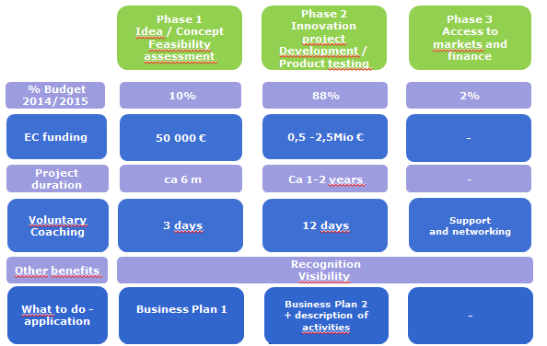
SME Instrument… 'Champions league' for the most innovative

Slide 7
COSME (1)
EU programme for competitiveness of SMEs.
..Better access to finance and markets
..Ukraine and COSME?
..Networks (EEN)
Notes:
Two years ago Ukrainian citizen's demanded a country that looked ahead towards Europe, not behind to the past. The EU has responded with a determination to help Ukraine in the short, medium and long-term.
Our common goal is a reformed Ukraine – democratic, united and prosperous. A reformed Ukraine that realises the ambitions of its people.
Our partnership is based on shared values and on this foundation our support will help the Ukrainian people build a stronger economy, a stronger society and a stronger country.

Slide 8
COSME (2)
Enterprise Europe Network
World's largest support network for SMEs..
..in 60 countries
..with 600 partner organizations
..4500 professional advisers
EEN.EC.EUROPA.EU
Notes:
The world's largest support network for SMEs
Combines international business expertise with local knowledge.
Helps ambitious European businesses at their doorstep:
-to innovate
-to increase their competitiveness
-to expand their business internationally inside Europe -and in growth markets beyond the EU

Slide 9
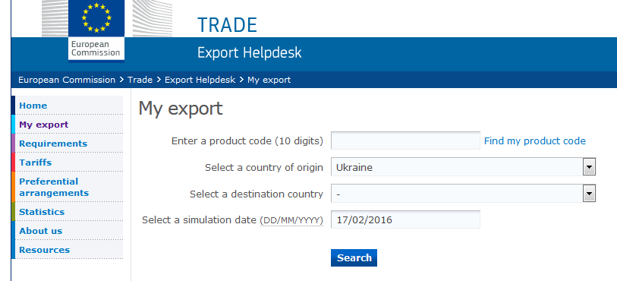
EU Export Helpdesk
EXPORTHELP.EUROPA.EU
Notes:
Exists guidebook in RUSSIAN, available on the EU Export Helpdesk site (click upper right corner, "Languages: Russian" and it takes you to the guideline. In PDF, so it is a bit outdated, as it is from 2013 April. Main idea of how the system works is there.

Slide 10
New EU4Business
Technical Assistance
Network of 15 Business Support Centres
with the EBRD, reaching out to
30, 000 Ukrainian SMEs
Significant funding
Notes:
- Technical assistance to MEDT in the deregulation process and to national, regional and local authorities to formulate and implement sound SME support policies (EUR 7 m)
- EU4Business: network of Business Support Centres (EUR 40 m)
- Contribution to the EIB/EIF Guarantee facility (EUR 40 m)
Support to Ukraine to join Horizon 2020 (EUR 7 m)
At least 30,000 Ukrainian SMEs will be reached through direct assistance, training or communications-related activities, including:
• 5,000 SME owners, managers and consultants will benefit from training activities to improve their skills
• At least 400 will benefit from direct advisory support by local consultants and international advisers
• At least 50 SMEs will obtain direct financing from the EBRD for a total value of at least EUR 100 million

Slide 11
Other EU support to SMEs
EU funds..
..EIB/EIF Guarantee Facility
..East Invest II
..EBRD Small Business Support, phase II and Women in Business
..SME Finance Facility
..DCFTA Facility for SMEs (EBRD, EIB) – SMEs in Ukraine, Georgia and Moldova to adapt to and benefit from the DCFTA (EU4Business)
Notes:
Access to loan finance: one of the biggest challenges for SMEs => high interest rates and high collateral requirements.
Some SMEs do not have the appropriate financial history or are lacking sufficient collateral, but are still doing good business: the Guarantee Facility instrument will target this market segment as a priority.
Potential benefits for SMEs (on top of access to finance):
Reduced collateral requirements
Longer loan maturities
Lower cost of borrowing for SMEs

Slide 12
Thank you for your attention!
Boris FILIPOV, boris.filipov@eeas.europa.eu
https://www.facebook.com/EUDelegationUkraine/
http://eeas.europa.eu/delegations/ukraine/
https://twitter.com/EUDelegationUA

